Slide 1
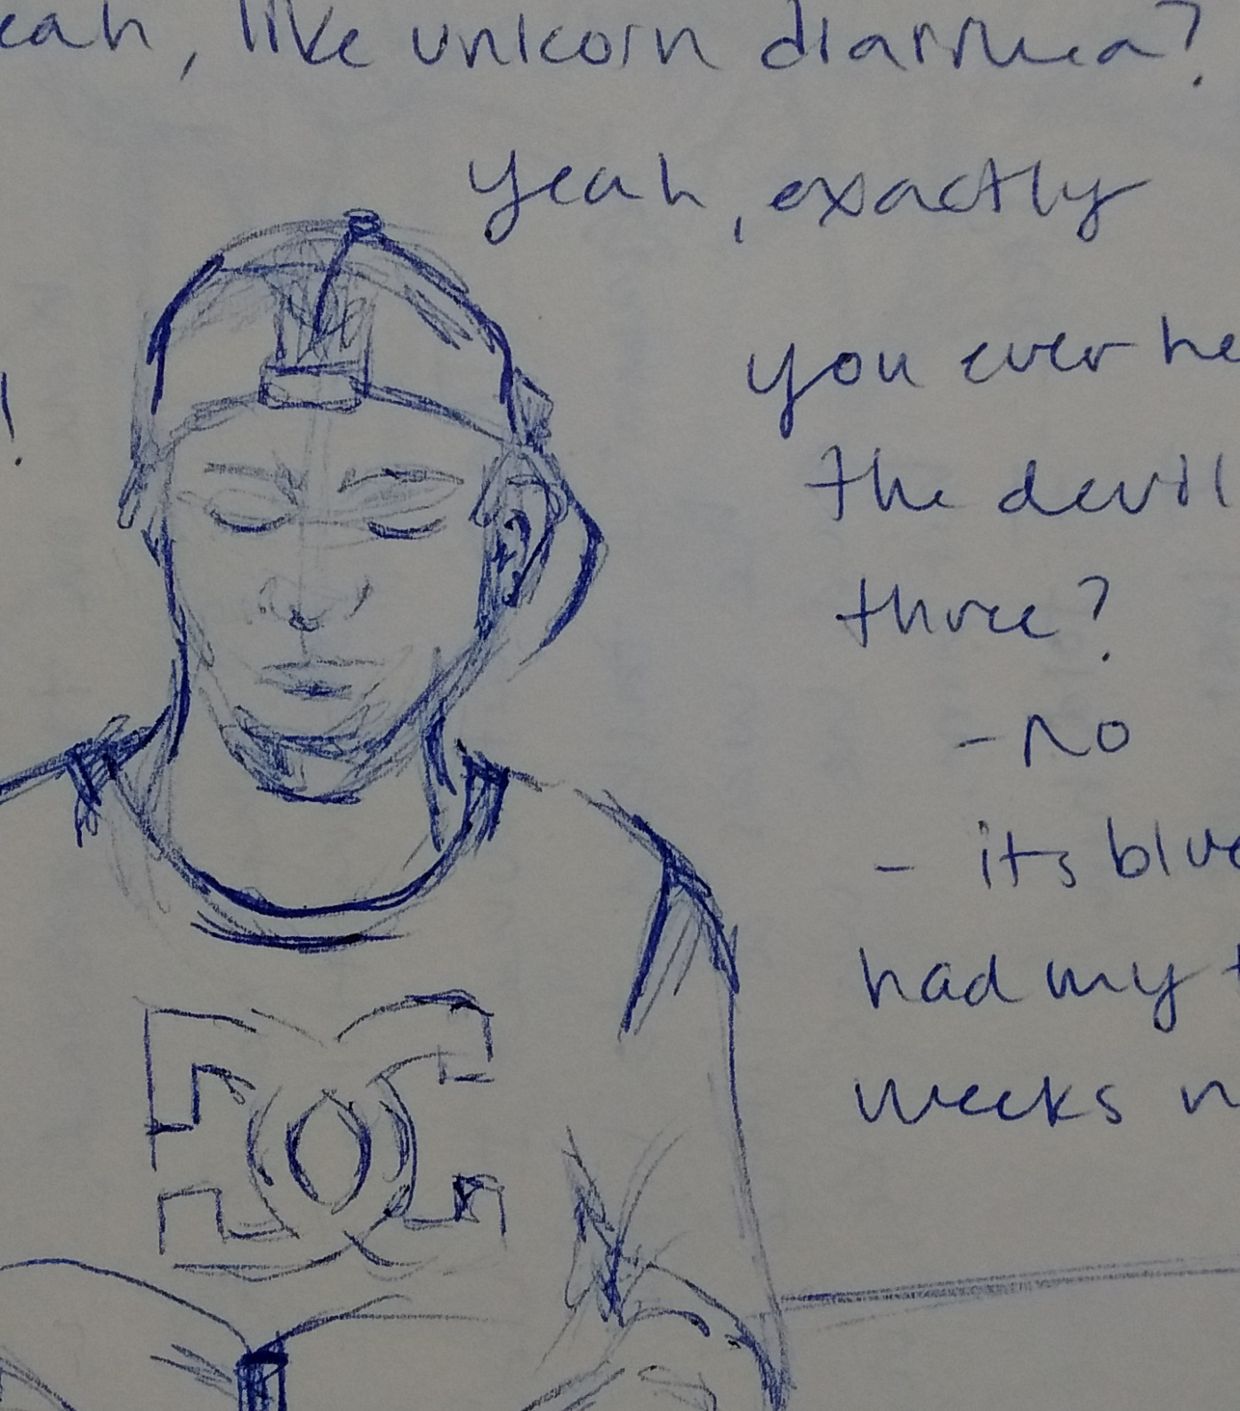
Contour Portraits

Slide 2
https://www.youtube.com/watch?v=V1TMR-NiS14

Slide 3
‘Kiptoe’ Street Artist

Slide 4
“Three Saints”

Slide 5
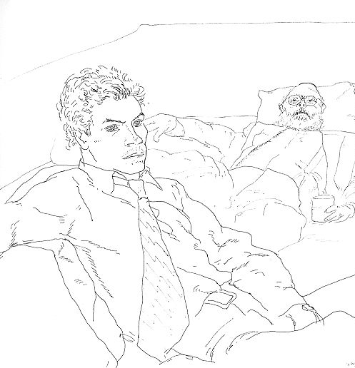
Ways to Improve your Contour Portrait
Contour drawings focus on the outline of the subject, but that doesn’t mean you can’t draw anything but the outline. You can capture details within the subject like the lines of a shadow or folds in fabric, or lines of the face.
Line Variation: Just because you aren’t using value doesn’t mean your portrait can’t look three dimensional. You can vary the thickness of the lines you make to show a subject’s volume. Thicker lines mean the edge is heavier or more defined while thinner lines means this edge may be a an inner detail of the form. Thicker lines in the foreground of your portrait next to thinner lines in the background creates depth.

Slide 6
Kim Jung Gi

Slide 8
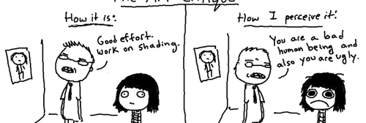
Learning Objectives
I can: Create an accurate an expressive contour portrait using only line to denote depth and dimension.
I can: translate the three-dimensional subject I see in front of me into a two-dimensional drawing on a picture plane.
I can: capture the essence of the person I am drawing while accurately depicting anatomy and proportion.
I can: reflect on my own work and the work of my peers by analyzing and evaluating the technical proficiencies and expressive qualities of contour portraits.

Slide 9
Dove Beauty
https://www.youtube.com/watch?v=XpaOjMXyJGk

